Slide 1
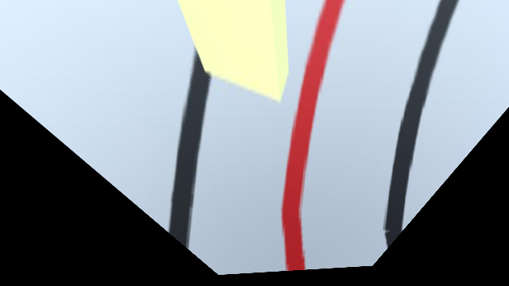
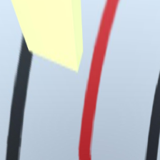
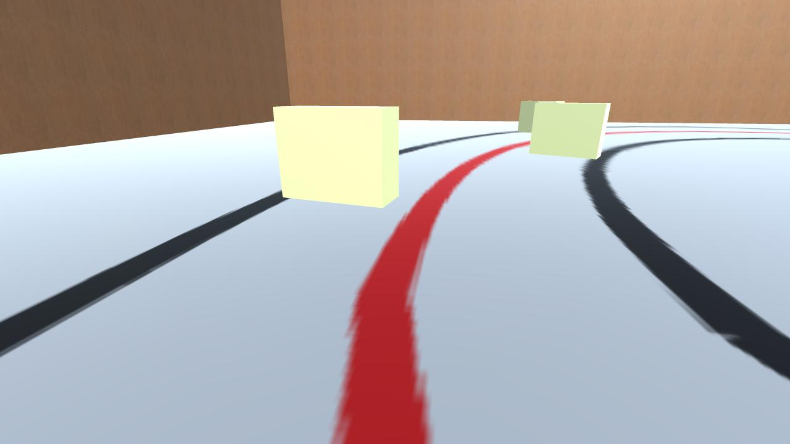
Data Preprocessing
Model
Warp Image
(with CAM’s config)
Dataset
(Snapshot from Unity)
Training Result
Crop Image
(Only part we need)
Predict Result
Resize Image
(224 x 224)
Image from Camera
(Live Image)

